Slide 1


Rogue Chess Team 15: Travis Head, Jose Herrera
Sponsor: Pranav Dhulipala

Slide 2
Team:15 Rogue Chess
Game Functionality (Jose)
Board
Move Chess Pieces
Legality of move
Artificial Intelligence (Travis)
User Interface (Jose)
Application
Neural Network
Main Menu
Settings
Android
Phone
Cloud

Slide 3
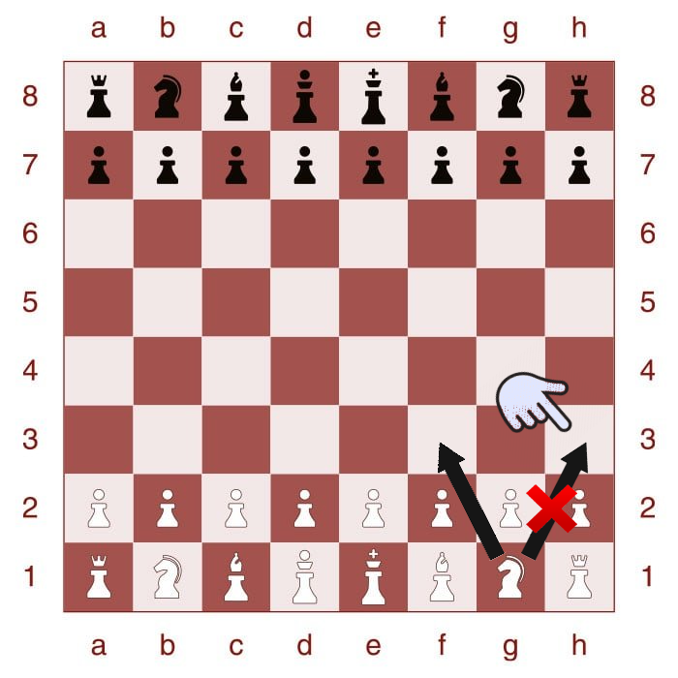
Project Deliverables
Develop an app of a new chess variation for Android product.
Develop an AI for Single Player Mode
Create a User Interface for the players interaction
Highlighted boxes to assist the player in making the next move legally
Create different difficulty levels
Upload the contents to the cloud

Slide 4
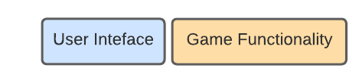
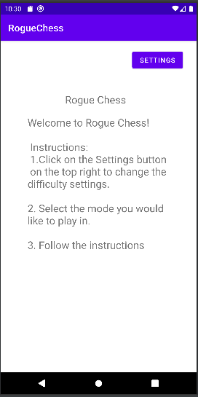
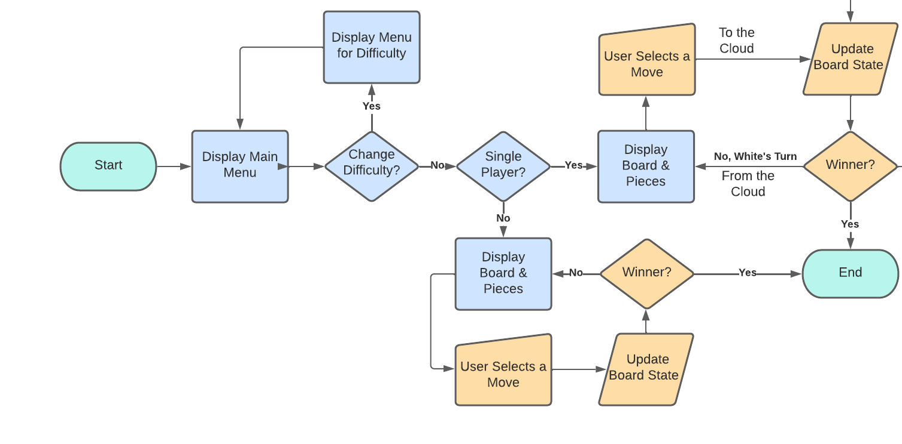
User Interface/Game Functionality
Jose Herrera
Accomplishments since the last presentation 29 hrs | Ongoing progress/problems and plans until the next presentation
Title Menu Setting Button Home Button Instructional Page | The emulator is crashing Add Difficulty Buttons Add Chess Board Add Chess Pieces Add Highlights for the next move

Slide 5
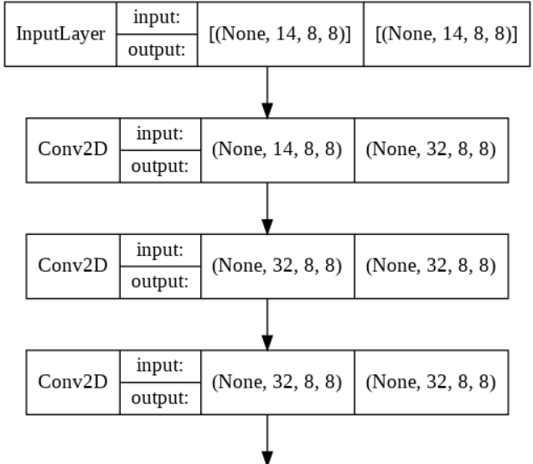
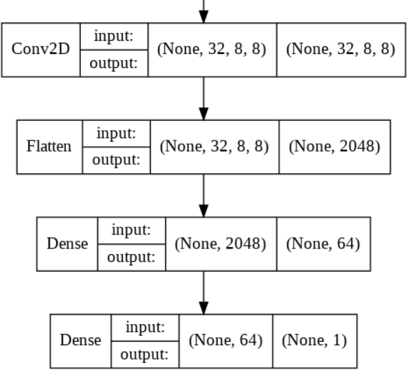
Artificial Intelligence
Travis Head
Accomplishments since the last presentation <25> hrs | Ongoing progress/problems and plans until the next presentation
A.I. recognizing board states A.I recognizes valid attacks Can output a score for the board state using Stockfish Neural Network producing convolutional layers | Replacing dataset with generated board states Had to rewrite code due to changes Need to train and test A.I. Need to run in Microsoft Azure

Slide 6
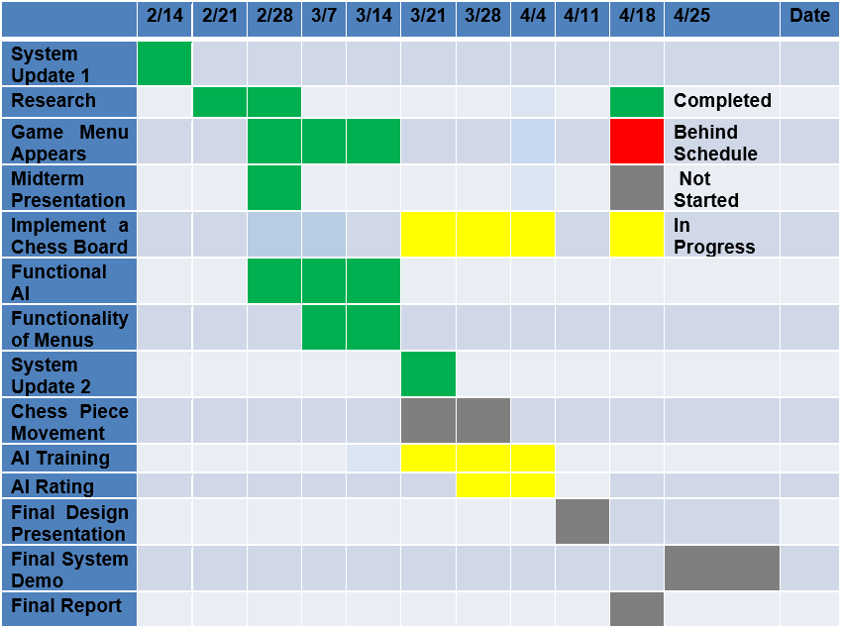
Execution plan

Slide 7
Validation plan
Paragraph # | Test Name | Success Criteria | Methodology | Status | Responsible Engineer
8.2.2.1 | Data Size Requirements | Application is under 20Mb. | View file size and validate. | Untested | Jose
8.2.3.1 | Randomization Difficulty | 90%, 70%, or 50% obedience rate corresponding to Easy, Medium, Hard. | Record obedience successes on 100 moves from each setting. | Untested | Jose
8.2.3.2 | Chess Piece Movement | Each type of Piece moves only to respective ruleset. | Place each piece in the center/edge of an empty board and input a move to expected and unexpected valid tiles. | Untested | Jose
8.2.3.4 | App Menu Functionality | Main Menu is visible, and each option is selectable. Selecting a game mode starts a match. Difficulty option opens a new menu that saves selected setting. | Open the application and validate main menu is visible. Select each option on the menu. | TESTED | Jose
8.2.1.5 | App Graphics | Menus, board, pieces, and highlighted tiles are all visible when needed. | Open the application and validate visibility. Start a match in each mode and select/deselect pieces. | Untested | Jose
8.2.1.6 | Artificial Intelligence Rating | Elo Rating of at least 1300. | Run the AI against another chess program for 10 matches at ratings of 900, 1100, 1200, 1300, 1400, and 1500. | Untested | Travis
8.2.1.7 | Artificial Intelligence Movement | Artificial Intelligence can input a valid move on its turn. | Input a board state and run the AI with a written output. | Untested | Travis

Slide 8
Questions?

